Slide 1

Entropy Softworks Customer Research Survey for Speed Typing Website
Tobin Chin

Slide 2
Questions: What was asked
- About how many times a day do you train to use a keyboard?
- Do you know your current typing speed?
- Would you like to improve your typing speed?
- Do you currently use a tool to test your typing speed?
- How did you learn to type?
- What do you use your typing skills for? How much of your day is spent typing or using a keyboard on a computer?
- How do you feel about paid memberships and subscription services?
- Would you pay for benefits to your profile on a social media account?
- What do you like about Monkeytype? What elements from this would you like to see in a tool?
- What do you like about TypingTest.com? What elements from this would you like to see in a tool?

Slide 3
“I like the ability to access it online”

Slide 4

Cross-machine ability
While it isn’t helpful to port this to phones, the application should be able to transfer information from machine to machine. Part of keeping track of data and information is keeping it constant, and easily constant across different machines.

Slide 5
“I don’t practice typing frequently”

Slide 6
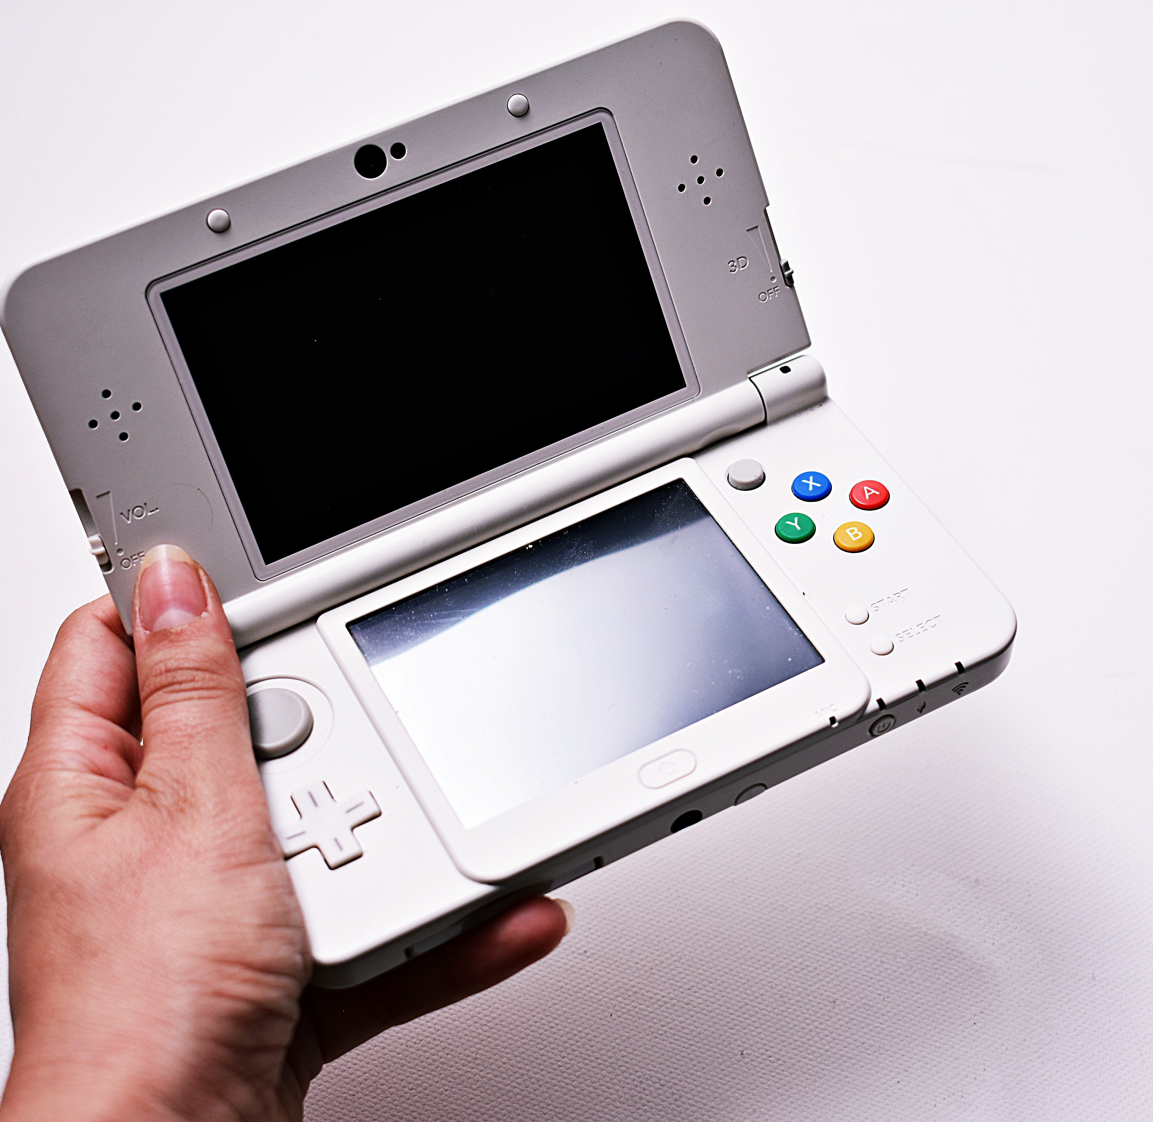
Make it Easy to Pick up and Put Down
While it isn’t helpful to port this to phones, the application should be able to transfer information from machine to machine. Part of keeping track of data and information is keeping it constant, and easily constant across different machines.

Slide 7
“I hate online memberships; I would never pay for one”

Slide 8

No Ads, no members
Allowing users the ability to crowdsource, by keeping the development team small and ingratiating them to the user base we could encourage donations to fund the tool. In addition, we could offer a certificate, just like other websites do, to allow users to certify their progress as an official document for jobs and work. Charge companies who can pay for it, instead of damaging the experience for the common person.
This Photo by Unknown Author is licensed under CC BY-SA

Slide 9
“The clipart looks cheap”

Slide 10

Clip art Cheapens the medium
The Clipart distracts from the actual typing. Having many different disparate styles distracting from the actual task of typing makes the task of typing harder. Removing things which do not add to the experience can help in typing speed and user experience. Clipart makes things feel unpolished.
See? This dog doesn’t make sense here! ->

